Slide 1

Connection & Community at

Slide 2


What is SpacesShared?
SpacesShared is a technology platform and a team
We provide a way for people interested in homesharing to find suitable matches based on preferences, location and personality while prioritizing safety and providing support along the way

Slide 3

Our
Mission
To change the way the
world lives together by
turning shared spaces
into homes, and spare
bedrooms into opportunities.

Slide 4


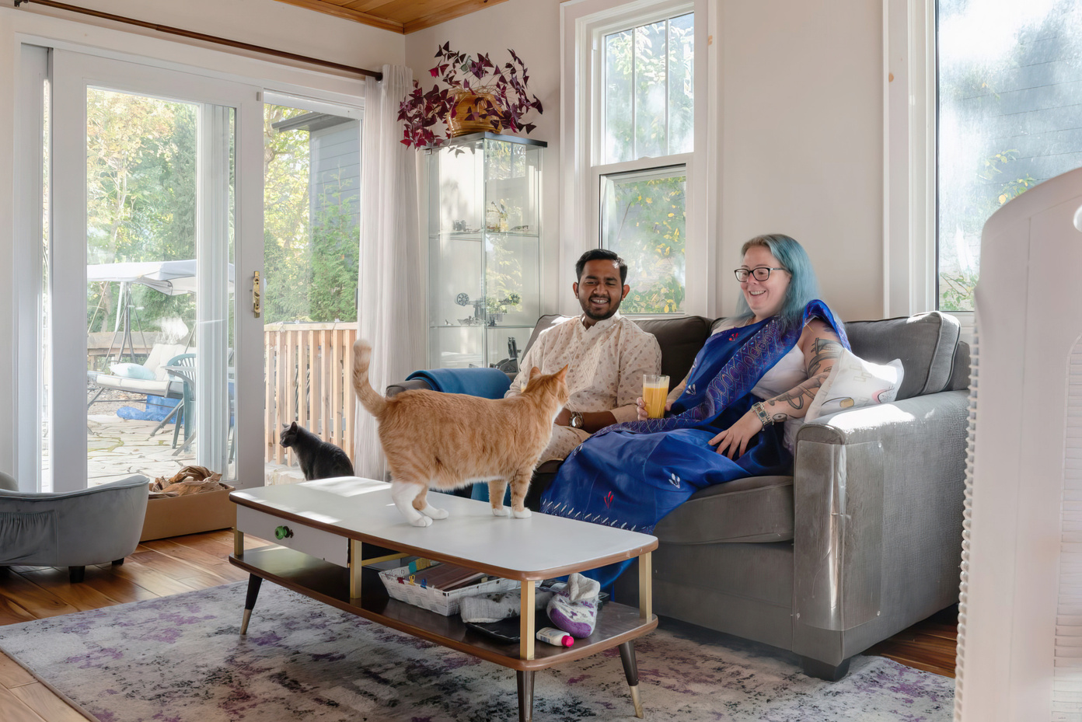
Homesharing has been around forever!
Informally or formally,
everyone seems to know someone
who has done homesharing.

Slide 5



What is
Homesharing?
Living with someone and sharing common spaces in a home such as the kitchen, bathroom etc.
Notes:
Homesharing is not new
What often stands in the way of people doing it is safety and the fear of having a bad experience, so we made spacesshared to try and address these barriers that prevent this very old concept from becomming more popular

Slide 6

Person
paying the rent = Guest
Person receiving
the rent = Host

Slide 7

Adults & Older Adults
Put their spare rooms to work, creating companionship, some extra income, and a little help around the house
Using capacity that already exists in our communities
Students
Find compatible, older adults to live with and lower housing costs
Post-Secondary Institutions
Helping students find high quality housing and build deep roots in their community​

Slide 8
Our
Process
5. Payments
Guest moves in, payments begin
4. Agreement
Finalize agreement on the platform
3. Match with housemate
Match, chat and video call on the platform
2. Tell us about yourself + ideal housemate
Set housemate preferences
1. Tell us about your home
Verify ID, Address (if host)

Slide 9

Regular
Feedback
SpacesShared conducts monthly check-ins with Hosts and Guests.
Users can also reach out to our Customer Success team with questions at any time.

Slide 10
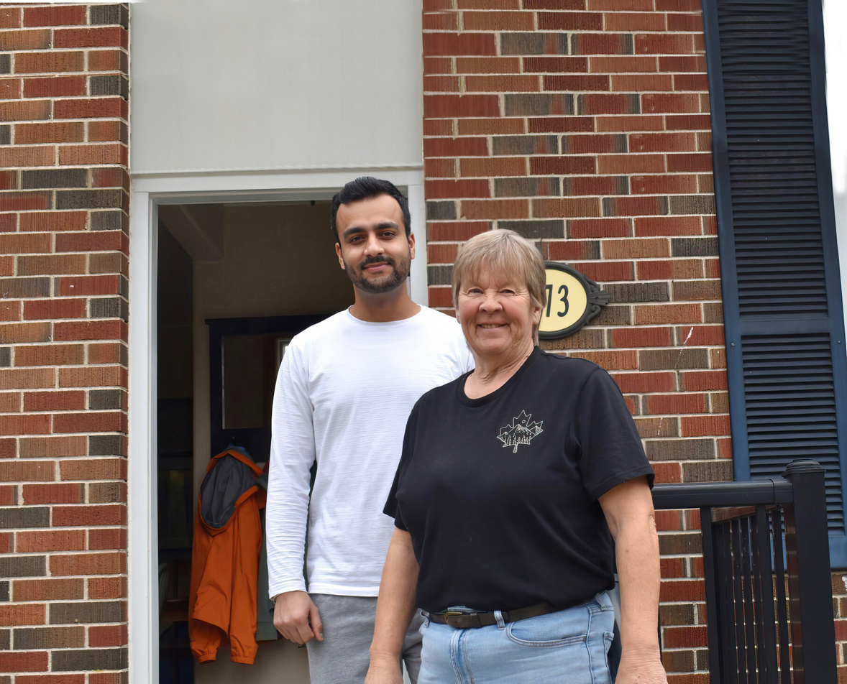
Has a spare bedroom with a door
Comfortable with Guest using the kitchen and other common areas of the house
Feels positively about participating in a homesharing arrangement
Appreciates having new experiences
Communicates expectations clearly
Demonstrates empathy
Characteristics of a
successful Host

Slide 11
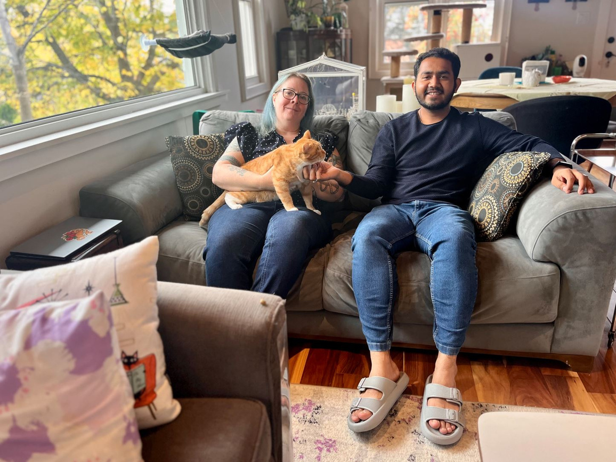
Compatibility
Effective Communication
Respect and Consideration
Flexibility
Openness to new experiences
Feeling of Safety
Clear agreements
The ingredients of
a good match

Slide 12

Companionship
Light household assistance
Tech support
Unplanned interactions
Extra set of hands
Potential to be a mentor
Give back to community
Extra income
Host Benefits

Slide 13

What is the expected extra Income?
Suggested Monthly Rent Range
$400 - $850*
Monthly Admin Fee
*Rent range varies based on location

Slide 14




Affordable rent for a room that feels like home
Option to make a contribution in their home
Help with acclimatizing to their new neighbourhood
Potential for mentorship by the Host
Opportunity of introductions, networking and to build relationships within their new community
Guest Benefits

Slide 15

We recommend that Hosts inform their home insurance provider that they will be homesharing.
Guests have their own liability and personal property insurance.

Slide 16

What about safety ?
Do not need to share your personal information, communications take place through the platform
Data is stored in Canada and SpacesShared complies with federal and provincial privacy regulations
Verified users:
All users must verify their identity, email address, and phone number
Hosts verify address, Guests verify student status.
Enhanced Criminal Background Checks before entering into homeshare agreement.

Slide 17

Are you ready
to homeshare
with a guest?

Slide 18

You’re ready to be matched!

Slide 19
www.SpacesShared.ca
CustomerSuccess@SpacesShared.ca
833-766-6329 ext 1
Notes:
Add - to book an appointment with our technical specialist dominika email dominika@spacesshared.ca

