Slide 1
STATUS UPDATE TO NL PUBLIC SECTOR PENSIONERS’ ASSOCIATION
Presented By: Levi May, CFO
October 10, 2024

Slide 2


Teachers’ Pension Plan
The Teachers’ Pension Plan Corporation (TPPC) is the Administrator of the Plan and the Trustee of the Pension Fund responsible for investment of the Fund
The Sponsors of the Plan (the NLTA and Government of Newfoundland and Labrador) have joint responsibility for plan design and any consideration of plan amendments rests with the Sponsors

Slide 3

Our Mission
Our mission is to provide retirement security and outstanding service to our members
Since our formation 8 years ago, we have been focused on de-risking the Plan’s investment strategy, lowering volatility of returns and improving service to members

Slide 4
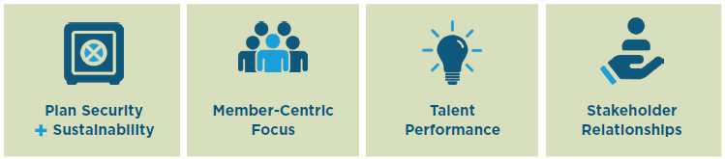
Strategic Planning
Strategic Planning has been top of mind for us since inception
We have been developing and executing on our strategic priorities since that time
We are in the final year of our 2022 to 2024 Strategic Plan and have achieved the key Corporate goals
We are currently in the process of finalizing our Strategic Plan for 2025 to 2027
includes the strategic priorities, action plans and individual goals to achieve the Corporate goals

Slide 5

Investment Results
Our results show the continued strength and resilience of our financial position
We continue to demonstrate our commitment to achieving stable returns over the long-term
Our investment strategy’s effectiveness and prudent risk management are evident
Includes a recognition of the importance of considering Environmental, Social, and Governance (ESG) factors to not only mitigate risk but to also identify investment opportunities
In fulfilling our mission, we have a fiduciary responsibility to act in the financial best interest of our members
Responsible investing – incorporating relevant and material ESG factors into investment decisions and capital stewardship – plays a role in meeting our fiduciary obligations

Slide 6
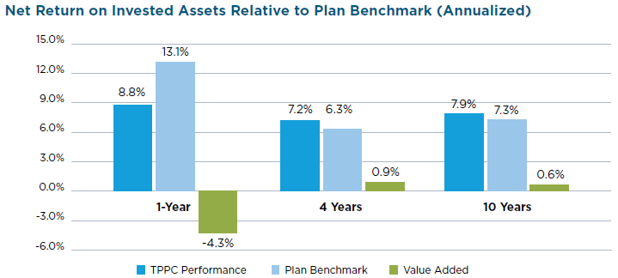
Net Return

Slide 7
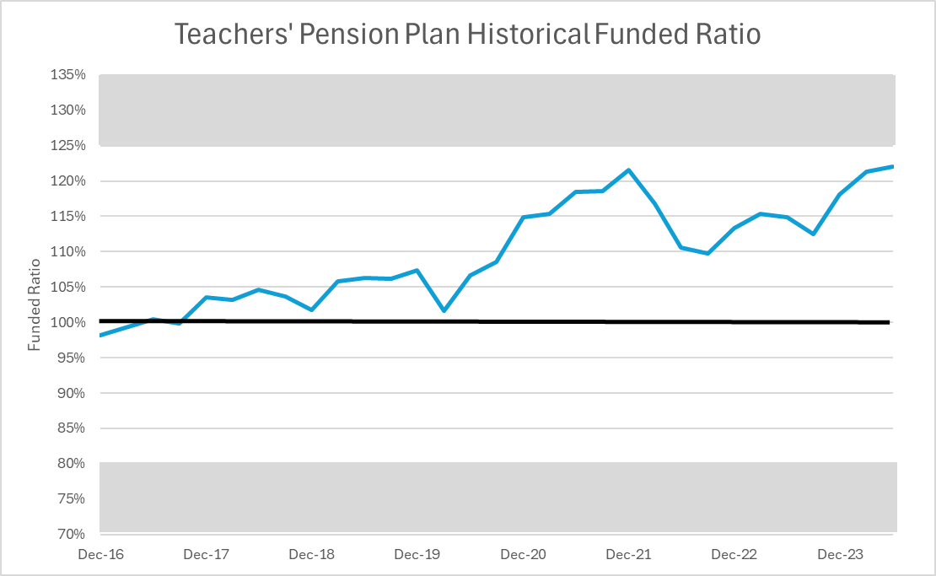
Fully funded for the 7th year in a row

Slide 8

Member Services
Our focus is on YOU – the member
Accurate information
Knowledgeable employees
Timely information
In our efforts to serve you better, we have embraced innovation
myPENSION, our member self service portal – available for active members and pensioners – allows us to make information available to you 24 hours per day

Slide 9
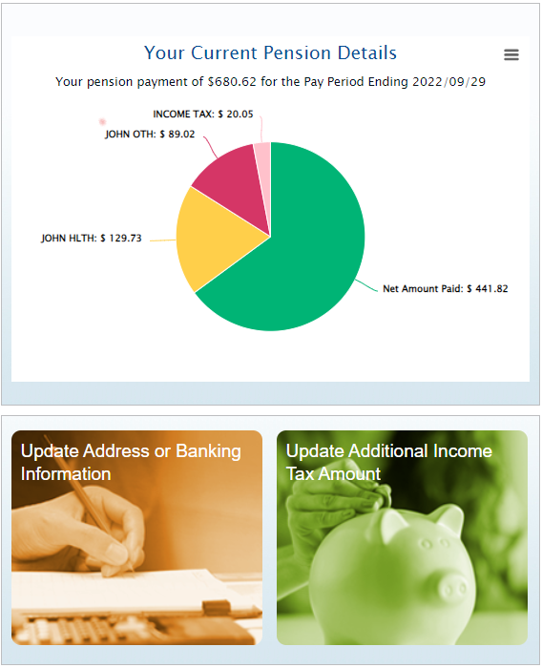
myPENSION Overview
Secure, web-based and integrated with the Teachers’ Pension Plan (TPP) Pension Administration System
Accessible from the TPPC website
Allows for secure document sharing
Available to active and retired members of the TPP
The portal for Pensioners provides access to pension payment cheque stubs (current and prior periods), document management, beneficiary designation, and other transactions such as banking information updates or requests for additional tax deductions
Review your member and pension information (including your CPP Bridge Benefit and the CPP Bridge Reduction Date)

Slide 10

Data Security and Privacy
Compliant with applicable TPPC policies covering privacy, data protection, and security
Registration requires data that uniquely identifies the member
Login requires a username and password
Multi-Factor Authentication (MFA) has been added for an additional layer of security
Cloud-based so no data is on your computer/device unless you download it
Session will timeout after 15 minutes of inactivity

Slide 11

If you have not already registered, we encourage you to register today!
We have dedicated and experienced employees ready to help you register
If online support tools do not provide the answer you need, you can contact the TPPC Pension Administration Support team at
Email: memberservices@tppcnl.ca
Phone: Local: 709-793-8772
Toll Free: 1-833-345-8772
Our website www.tppcnl.ca also contains news and lots of useful information about the Plan

Slide 12
QUESTIONS?

