Slide 1
Status Update to NL Public Sector Pensioners’ Association
Presented By: Levi May, CFO October 13, 2022

Slide 2
The Teachers’ Pension Plan Corporation (TPPC) is the Administrator of the Plan and the Trustee of the Pension Fund responsible for investment of the Fund
The Sponsors of the Plan (the NLTA and Government of Newfoundland and Labrador) have joint responsibility for plan design and any consideration of plan amendments rests with the Sponsors

Slide 3
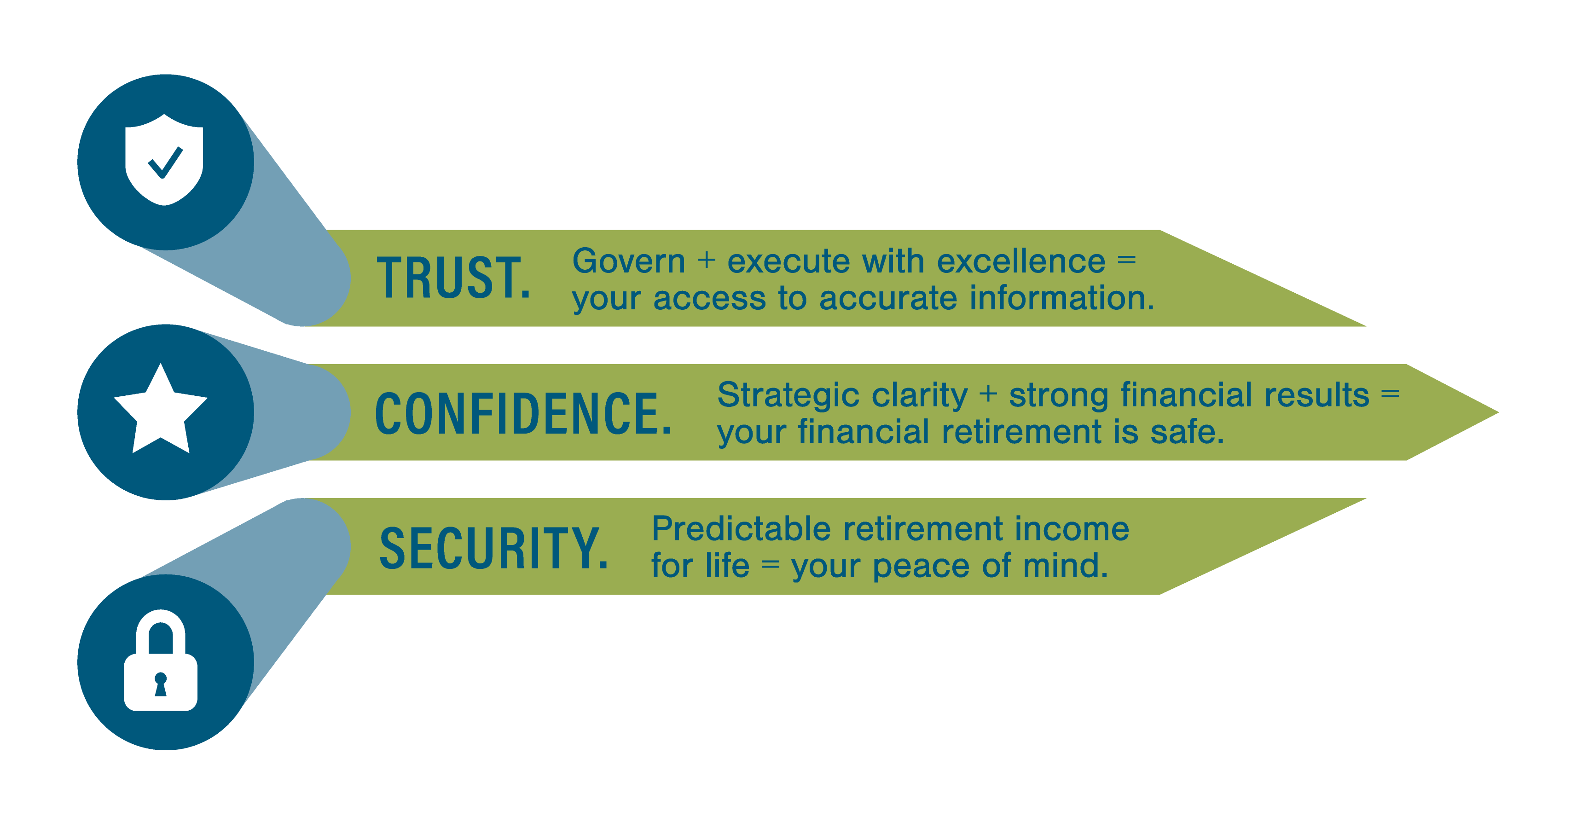
Our mission is to provide retirement security and outstanding service to our members
Since our formation 6 years ago, we have been focused on de-risking the Plan’s investment strategy, lowering volatility of returns and improving service to members
We have a Strategic Plan which we are executing on very well

Slide 4

Strategic Plan
Strategic Planning has been top of mind for us since inception
We have been developing and executing on our strategic priorities since that time
A new Plan was prepared in late 2021 to cover the period from 2022 to 2024
The key Corporate goals upon which our Strategic Plan is developed
Strategic priorities, action plans and individual goals are developed to achieve these Corporate goals

Slide 5
Investment Results
The Plan has continued to show great resiliency during the pandemic and delivered strong results
We provide a life-time benefit so we must be focused on the long-term while addressing immediate issues
The Corporation’s strategic focus and risk management process contribute to the Plan’s impressive net return on invested assets and funded ratio

Slide 6
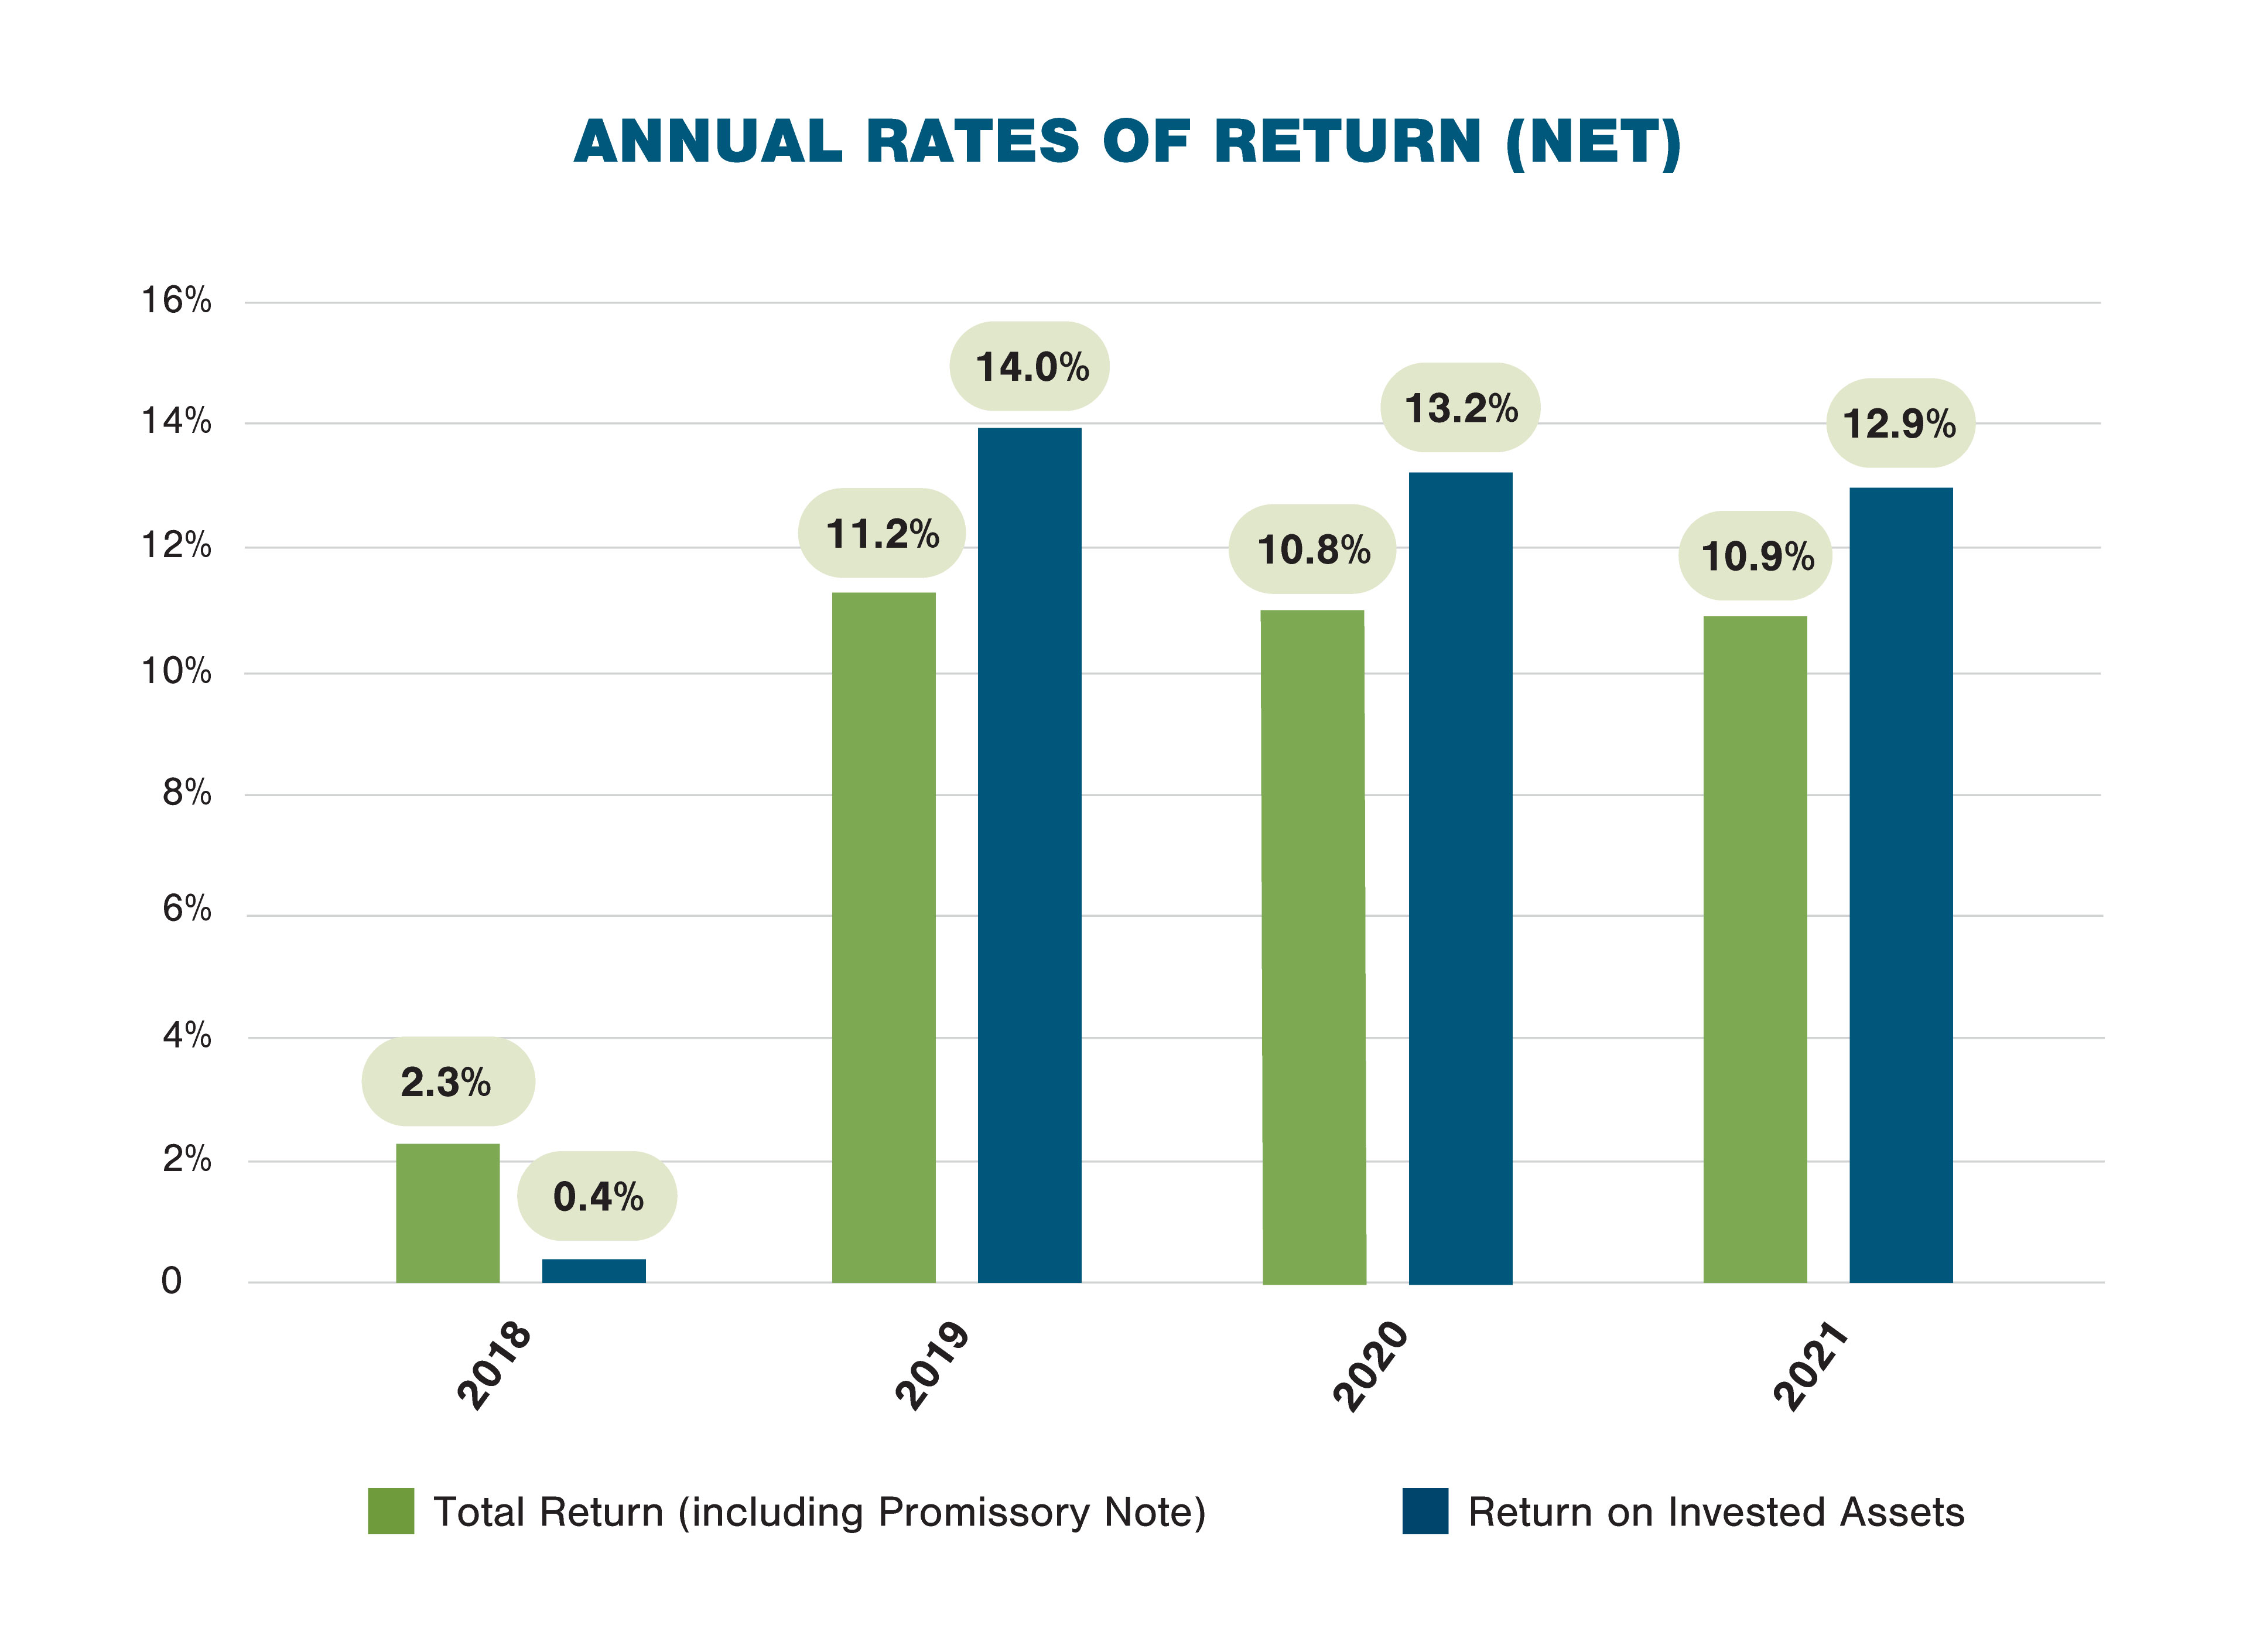
Net Rate of Return on Invested Assets (1 Year): 12.9%
Net Rate of Return on Invested Assets (5 Year Annualized): 10.1%
Funded Ratio of the Plan at December 31, 2021: 121.5%
A significant improvement since our inception

Slide 7
Member Services
Providing members with outstanding service is key to everything we do and is part of our culture
We strive to make everything related to our members’ pensions as easy as possible
Investments in technology have allowed us to make information available to you 24 hours per day through our Member Self Service (MSS) Portal – available for active members and pensioners
The pensioner portal functionality was launched in May 2022 and has many great features

Slide 8
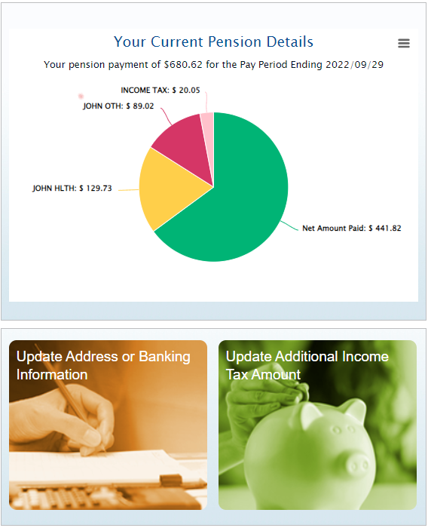
Key Features
MSS Portal for Pensioners
Access your paystubs for each pay period
Complete your beneficiary form for submission
Update your address or direct deposit information
Request that additional Income Tax be deducted
Review your member and pension information (including your CPP Bridge Benefit and the CPP Bridge Reduction Date)
Securely upload and download documents to and from TPPC

Slide 9
We encourage you to register today!
We have dedicated and experienced employees ready to help you sign up
If online support tools do not provide the answer you need, you can contact the TPPC Pension Administration Support team at
By Email: memberservices@tppcnl.ca
By Phone: Local: 709-793-8772
Toll Free: 1-833-345-8772
Our website www.tppcnl.ca also contains news and lots of useful information about the Plan

Slide 10
Questions?

