Slide 1

Mohamed Abdallah, co-founder - Executive Director

Slide 2
Connections for Seniors
Established in January 2018
Emergency accommodations and a wide range of services for older adults (55+) facing homelessness

Slide 3
Mandate
To empower seniors to overcome barriers to safe and affordable housing, and provide support services that help reduce risks to well-being and promote quality of life. We believe that all seniors have the right to feel safe, to feel healthy, and to make choices about their own lives.

Slide 4
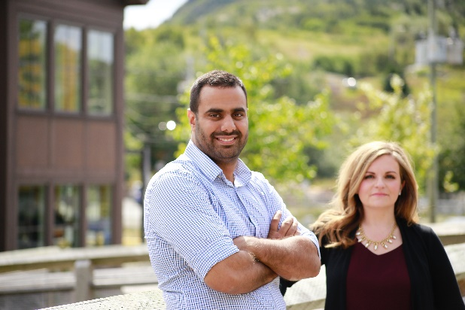
Our Story
Identified gap in supportive services to older adults facing homelessness or crises
Connections for Seniors was founded with the overall goal of making the experience of homelessness less traumatizing and more supportive for seniors

Slide 5
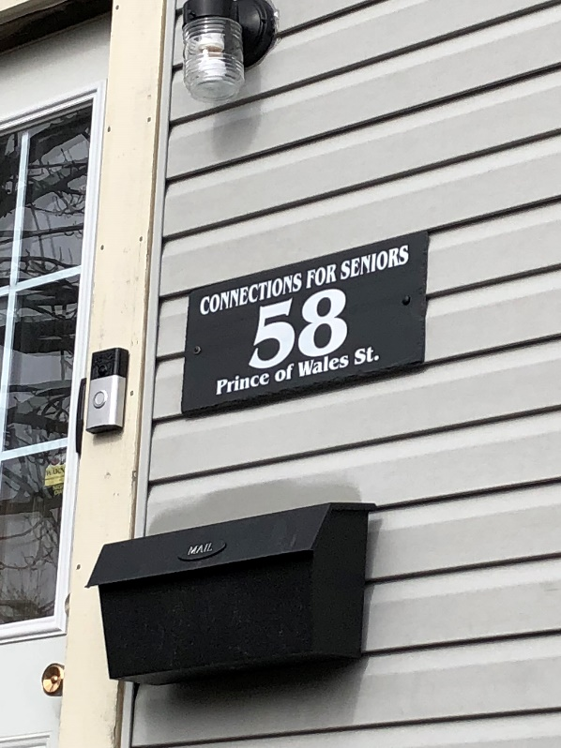
Emergency Shelter
Location: Residential area (Prince of Wales St.)
11 rooms
8 funded by NLHC
3 community
3 properties
Individual, locked rooms
Shared washrooms
Common area with telephone & computer access
Large dining room & kitchen

Slide 6
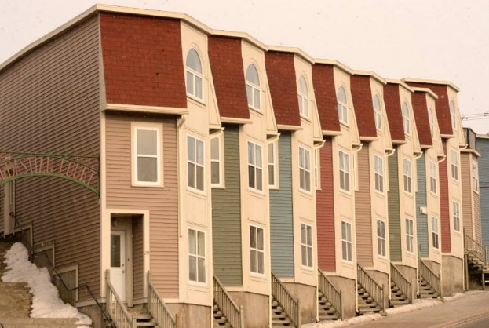
Supportive Housing
Emerging from a need for supportive housing designated specifically for seniors who have experienced barriers to securing housing, Connections for Seniors has established a
Partnership with the City of St. John’s - helps older adults to exit homelessness in a way that preserves dignity and fosters stability.
The ultimate goal of this program is to support seniors to thrive and engage in the community and to promote quality of life.

Slide 7
Housing Options for Seniors
Personal Care Home
Community Care Home
Private Market Housing (apartment)
Supportive Housing
NLHC Housing Units/Subsidies
Board & Lodging
Bedsitting/Room Rental
Family Reconnection

Slide 8
Intensive Case Management
Intake process for programs includes signed consent for health
Working with physicians, health departments, and pharmacies
Discharge planning
Finding suitable, long-term, safe housing
Providing transportation related to health, housing, and food-related needs
Attending medical appointments
Acute mental health support
Income tax preparation
Financial systems navigation
Legal and justice systems navigation
Follow-up in the community once housed
Working with community partners to achieve best outcomes, provide wrap-around support and advocacy

Slide 9
Health & Community Outreach Program
This program provides case management and transportation services to seniors in the community who require significant support with maintaining health and well-being.
Individuals and couples enrolled in this program include seniors who live independently but remain at risk for housing precarity and who have health, financial, and legal matters that are interconnected with housing stability.

Slide 10
Housing & Homelessness Outreach Program
Developed in partnership with SeniorsNL, Newfoundland & Labrador Housing Corporation, Connections for Seniors, and the Department of Immigration, Population Growth, and Skills
New Horizons for Seniors Pan-Canadian Project Grant.
A Housing Support Worker (HSW) provides case management services and develops housing plans for anyone age 55+ in any shelter.
The HSW coordinates and expedites the process of seniors exiting homelessness by providing support and transportation related to housing needs.

Slide 11
Housing Stability &
Homelessness Prevention Program
Funded by End Homelessness St. John’s (Begin June 2021)
Program participants include anyone aged 55+ who is living in the community and experiencing eviction or risk of housing loss.
A Housing Support Worker (HSW) provides case management services, landlord mediation, support with navigating residential tenancies systems, and crisis intervention to those who need help with urgently securing housing.

Slide 12




Food Security Program
Developed based on the needs of the community following “Snowmageddon” and the onset of the COVID-19 Pandemic
Referrals regarding food needs in the community
Coordinates the pick-up and delivery of food hampers from local food banks, including CFS’ emergency food bank for delivery to seniors in the community.
Established partnerships include Bridges to Hope Food Bank, Food First NL, Hungry Heart Café and Manuel’s River Café cooked meals have been provided to the community, as well as our shelter and supportive housing clients.

Slide 13
Volunteer Program
Seeks to address social isolation and food insecurity among seniors.
Intent was to assign volunteers to more socially isolated and at-risk seniors for in-person friendly visits.
This program has been adapted to accommodate the needs of the community during the COVID-19 pandemic, with an emphasis on delivering food hampers and offering friendly telephone calls to socially isolated seniors.

Slide 14
Transportation Program
Transportation provided for health needs including doctor’s appointments, diagnostic appointments, dialysis, chemotherapy, and support with accessing medications
Transportation provided for housing needs including apartment viewings, acquiring furniture and household items, banking needs, and admission to personal and community care homes.
Transportation provided related to food needs including pick-up and delivery of food hampers, rides related to picking up groceries, as well as pick up of groceries for individuals with illness or disabilities.

Slide 15

Home Share
International, community-based program
Students and seniors share a house or apartment to their mutual advantage
The aging population are living in homes that they sometimes struggle to maintain alone
Home Share matches seniors with post-secondary students to share household responsibilities
Seniors have found it easier to stay in their own homes, and benefit from the youthful presence students bring along.
Quality of life benefits, emotional and financial stability, a sense of safety, and companionship are all goals Home Share aims to achieve for its 50+ participants.

Slide 16
Connections for Seniors
Programs
Housing
Outreach
Community support
Home Share
Volunteer
Food Security
Recreation
Director of Programs & Services
Executive Director
BOARD OF DIRECTORS
Accounting& Finance
Human Resources
Emergency Housing
Supportive Housing
Transportation
Health & Community Wellness
Housing Support
Homelessness Prevention

Slide 17
Referrals – Emergency Housing
Newfoundland & Labrador Housing Corporation
Eastern Health
30+ Agencies and Departments that refer to us
Self-referrals

Slide 18
Referrals – Other Agencies
SeniorsNL
Office of the Public Representative
Stella’s Circle
Wiseman Centre
First Light
The Gathering Place
Thrive
Self-referral
Eastern Health (Various Sites)
RNC
End Homelessness St. John’s (Coordinated Access)
Department of Corrections
John Howard Society (Turnings Program)
Tommy Sexton Centre
St. Vincent de Paul Society
St, John’s Status of Women’s Centre
Marguerite’s Place
Iris Kirby House
3 Birds Shelter
The Homestead Program
Empower

Slide 19
Challenges, Barriers and Gaps
Financial abuse
Capacity Issues – long wait times for geriatric psychiatric assessments that confirm lack of capacity related to decision-making and judgement
Need for trusteeship arrangements
Sustainability – creating social programs for the aging demographic, maximizing province-wide impact.

Slide 20
Goals
Establish non-profit model for home support services
Establish a non-profit Personal Care Home model
Increase volunteer recruitment and capacity to compliment all programs
Improve accessibility at all CFS sites
Secure funding sources to expand programs & services
Increase awareness and inform policy regarding issues related to seniors

Slide 21
Questions & Discussion

